Slide 1
Market Analysis

Slide 2
MARKET ANALYSIS PROJECT
*Subtitle: Understanding Your Customers to Drive Targeted Strategies
*Team - PTID-CDA-NOV-24-248
* MEMBER’s - Shubham Mohanty
Athira M

Slide 3
PROJECT OUTLINE
This project contains Market Analysis the Data from project_orders
We have gathered data from Different Tables in the DataBase Should be Calculate the Market Analysis
The dataset includes essential information such as in
1.Aisles table aisle_id (Primary Keys) , aisle
2. Departments table department_id, (Primary Keys) department
3.Order Products Prior table order_id(Primary Keys) ,product_id, add_to_cart_order, reordered,
4 Orders table order_id,(Primary Keys) user_id, eval_set, order_number, order_dow,. order_hour_of_day, days_since_prior_order
5. Products table product_id, product_name, aisle_id(Primary Keys) ,department_id

Slide 4
DATA SOURCES
DB Name: project_order
Host: 18.136.157.135
Domain Name: projects.datamites.com
Username: dm_team20

Slide 5
ADVANCED ANALYTICS
Predictive Analytics:Forecasts future trends and outcomes using machine learning and statistical models
Sentiment Analysis (NLP): Analyzes consumer emotions and opinions from textual data to understand brand perception and emerging trends
Machine Learning-Based Consumer Segmentation: Uses advanced algorithms to segment markets in a highly granular and dynamic manner based on complex behaviors and preferences
Causal Inference & Econometrics: Identifies and measures cause-and-effect relationships to understand how specific actions (e.g., pricing changes, marketing campaigns) impact market outcomes

Slide 6
CHALLENGES & SOLUTION
Challenges
Overwhelming Data Volume
Overfitting
Complex Data Relationships
Unclear Objectives
Market Volatility
SOLUTIONS
DATA VISUALIZATION
CROSS-VALIDATION
DATA SIMPLIFICATION
SET CLEAR KPIS
PREDICTIVE ANALYTICS

Slide 7
References & Tools Used:
My SQL
External libraries
MS-excel
python
Visualization tools (Power BI)
Presentation tools ( Power Point)

Slide 8
Aisle to no of Product Distribution
Count of product_id | aisle | Count of product_id2 | aisle3 | Count of product_id4 | aisle5 | Count of product_id6 | aisle7
1254 | missing | 498 | cat food care | 302 | hot cereal pancake mixes | 173 | breakfast bars pastries
1235 | candy chocolate | 488 | spreads | 297 | bakery desserts | 172 | muscles joints pain relief
1084 | ice cream ice | 483 | canned jarred vegetables | 295 | frozen breakfast | 168 | kosher foods
1030 | vitamins supplements | 470 | dog food care | 291 | energy sports drinks | 168 | mint gum
1023 | yogurt | 462 | condiments | 291 | soy lactosefree | 159 | tofu meat alternatives
980 | chips pretzels | 458 | doughs gelatins bake mixes | 289 | baking supplies decor | 158 | cream
888 | packaged cheese | 457 | soft drinks | 284 | feminine care | 148 | butter
887 | tea | 453 | cereal | 280 | canned meat seafood | 146 | white wines
880 | frozen meals | 453 | dry pasta | 275 | facial care | 145 | prepared soups salads
869 | cookies cakes | 426 | cold flu allergy | 268 | specialty cheeses | 130 | baby bath body care
826 | energy granola bars | 405 | marinades meat preparation | 264 | preserved dips spreads | 124 | eggs
813 | hair care | 399 | pickled goods olives | 253 | latino foods | 122 | fresh pasta
790 | spices seasonings | 398 | pasta sauce | 245 | skin care | 112 | eye ear care
781 | juice nectars | 385 | hot dogs bacon sausage | 242 | canned fruit applesauce | 112 | frozen dessert
740 | crackers | 384 | beers coolers | 241 | milk | 112 | trash bags liners
727 | soup broth bouillon | 382 | frozen appetizers sides | 239 | tortillas flat bread | 108 | indian foods
713 | baby food formula | 379 | fresh fruits | 236 | first aid | 105 | meat counter
673 | coffee | 374 | oils vinegars | 232 | red wines | 100 | packaged meat
671 | refrigerated | 369 | lunch meat | 228 | frozen meat seafood | 98 | packaged poultry
653 | cleaning products | 359 | frozen produce | 228 | honeys syrups nectars | 97 | refrigerated pudding desserts
619 | baking ingredients | 356 | fruit vegetable snacks | 225 | breakfast bakery | 95 | specialty wines champagnes
611 | packaged vegetables fruits | 352 | air fresheners candles | 222 | cocoa drink mixes | 85 | fresh herbs
602 | asian foods | 342 | water seltzer sparkling water | 216 | kitchen supplies | 83 | ice cream toppings
580 | nuts seeds dried fruit | 341 | canned meals beans | 206 | food storage | 82 | poultry counter
564 | fresh vegetables | 333 | digestion | 203 | dish detergents | 80 | frozen breads doughs
560 | oral hygiene | 333 | grains rice dried goods | 197 | shave needs | 79 | packaged seafood
555 | salad dressing toppings | 330 | frozen pizza | 196 | plates bowls cups flatware | 69 | trail mix snack mix
553 | bread | 325 | fresh dips tapenades | 192 | buns rolls | 54 | seafood counter
543 | other | 324 | protein meal replacements | 192 | spirits | 45 | frozen juice
539 | instant foods | 321 | paper goods | 190 | other creams cheeses | 44 | baby accessories
523 | soap | 315 | popcorn jerky | 187 | frozen vegan vegetarian | 32 | packaged produce
506 | laundry | 314 | deodorants | 185 | granola | 26 | bulk grains rice dried goods
502 | body lotions soap | 314 | prepared meals | 184 | diapers wipes | 12 | bulk dried fruits vegetables
 |  | 303 | more household | 178 | beauty

Slide 9
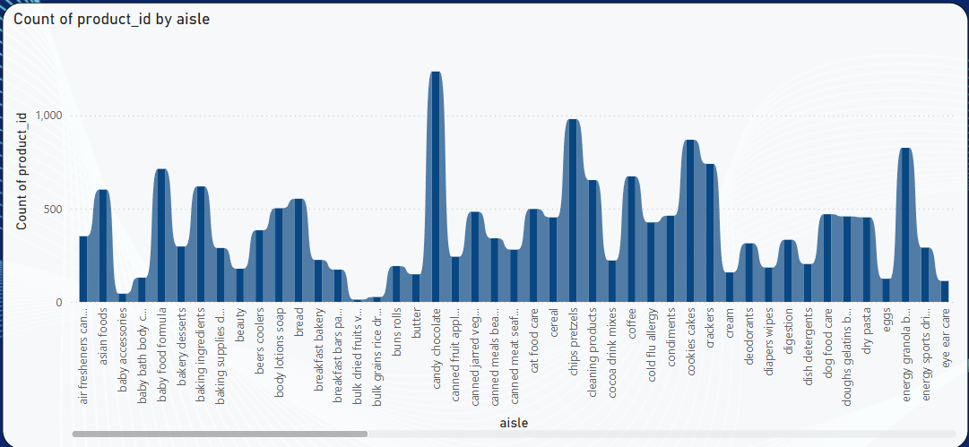
Product Category Distribution
Key Insight: There is a broad distribution of product categories, ranging from large categories (e.g., "missing", "candy chocolate") to niche ones (e.g., "bulk dried fruits vegetables").
Large Categories: Categories like "missing", "candy chocolate", and "ice cream ice" have the highest counts, indicating their prevalence or importance in the dataset.
Niche Categories: Categories such as "bulk dried fruits vegetables", "baby accessories", and "baby bath body care" have relatively low counts, suggesting they may be either less common or more specialized.
The top 10 categories with the highest counts are:
Missing: 1254
Candy Chocolate: 1235
Ice Cream Ice: 1084
Vitamins Supplements: 1030
Yogurt: 1023
Chips Pretzels: 980
Packaged Cheese: 888
Tea: 887
Frozen Meals: 880
Cookies Cakes: 86

Slide 10
Low Volume Categories (Bottom 10)
The 10 categories with the lowest counts are:
Bulk Dried Fruits Vegetables: 12
Bulk Grains Rice Dried Goods: 26
Packaged Produce: 32
Baby Accessories: 44
Frozen Juice: 45
Seafood Counter: 54
Trail Mix Snack Mix: 69
Packaged Seafood: 79
Frozen Breads Doughs: 80
Poultry Counter: 82
Beverage Categories
Beverages are also highly prevalent in the dataset:
Tea: 887
Soft Drinks: 457
Water/Seltzer: 342
Energy Drinks: 291
Juice Nectars: 781
Cocoa Drink Mixes: 222
Product Types with Significant Health/Food Focus
Health-Oriented: Categories like Vitamins Supplements, Energy Granola Bars, and Protein Meal Replacements highlight a growing trend toward health-conscious consumers.
Convenience Foods: Frozen Meals, Packaged Cheese, Frozen Pizza, and Prepared Meals are in demand due to their quick and easy-to-consume nature.
Products for Special Dietary Needs
Gluten-Free and Vegan: Categories like Frozen Vegan Vegetarian (187), Soy Lactose-Free (291), and Tofu Meat Alternatives (159) highlight a growing market for plant-based and specialized dietary products.
Kosher Foods: 168
Specialty Cheeses: 268
Household and Beauty Products
Several product categories cater to household and personal care needs:
Cleaning Products: 653
Hair Care: 813
Deodorants: 314
Skin Care: 245
Laundry: 506
Seasonal Products and Preparedness
Holiday-Related: Categories like Frozen Appetizers Sides, Frozen Breakfast, and Bakery Desserts reflect seasonally popular items.
Health and Safety: Items like First Aid (236), Cold Flu Allergy (426), and Shave Needs (197) indicate consumers' preparedness for health challenges.

Slide 11
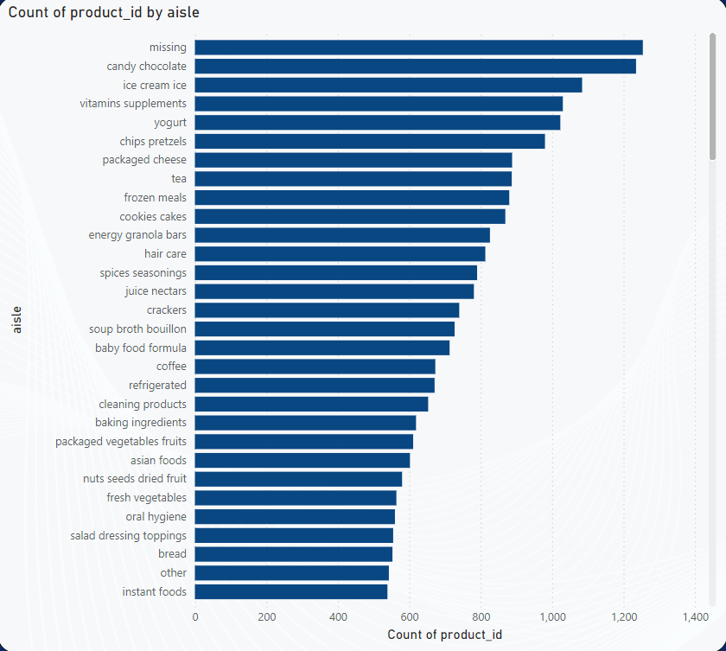
Opportunities for Growth
Underrepresented Categories: Categories like Bulk Dried Fruits Vegetables (12), Baby Accessories (44), and Packaged Produce (32) could represent opportunities for growth in specialized markets.
Evolving Categories: Increasing interest in Frozen Vegan Vegetarian and Soy Lactose-Free products suggests room for expansion in plant-based and alternative dietary product lines.
Summary and Recommendations
Diversification in Convenience and Health: The data suggests a demand for products that balance convenience (e.g., Frozen Meals) with health-conscious choices (e.g., Energy Granola Bars, Vitamins Supplements).
Specialization in Niche Markets: There is potential to expand in niche categories like Bulk Grains, Baby Accessories, and Specialty Wines.
Growing Categories: Focus on plant-based, lactose-free, and vegan products that are showing a rise in demand.
Promote Seasonal and Preparedness Products: Increase awareness for products like Frozen Appetizers, Frozen Breakfast, and Cold Flu Allergy products during peak times.

Slide 12
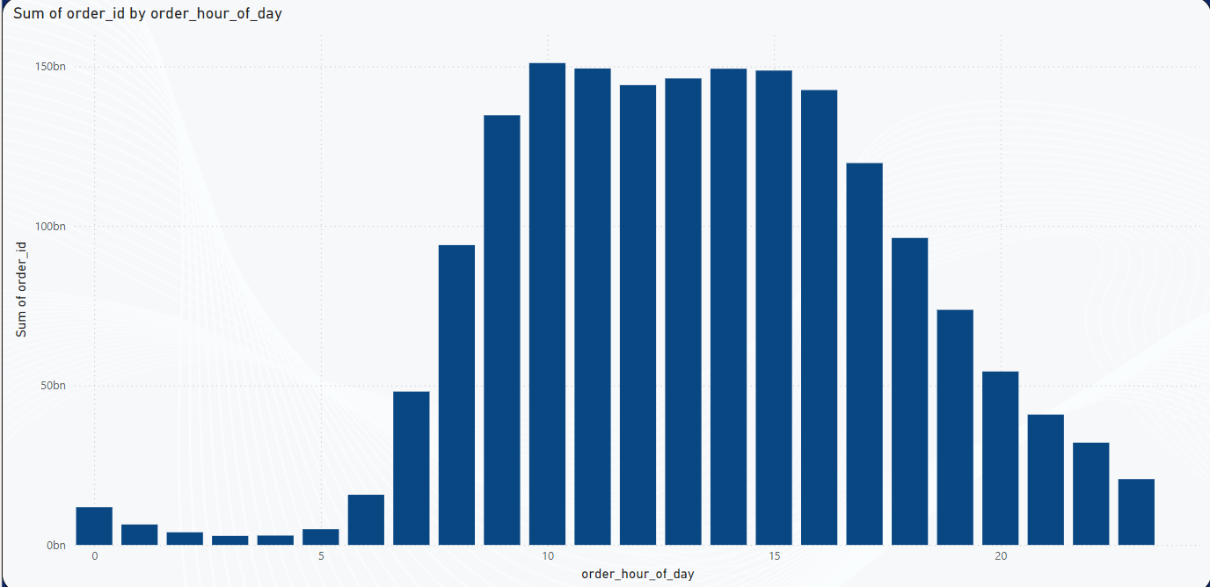
Orders Per Hour
order_hour_of_day | Sum of order_id
0 | 11,82,09,13,563
1 | 6,40,78,74,494
2 | 3,96,03,41,402
3 | 2,83,62,65,814
4 | 2,93,98,25,937
5 | 4,93,95,24,336
6 | 15,73,34,63,340
7 | 48,07,01,45,693
8 | 93,97,77,36,190
9 | 1,34,65,32,92,584
10 | 1,51,03,56,01,149
11 | 1,49,32,79,86,523
12 | 1,44,11,91,75,374
13 | 1,46,21,38,22,839
14 | 1,49,26,05,91,572
15 | 1,48,68,14,45,421
16 | 1,42,57,71,49,290
17 | 1,19,68,59,35,977
18 | 96,22,38,85,245
19 | 73,68,63,12,260
20 | 54,36,63,54,876
21 | 40,86,64,89,062
22 | 32,05,97,20,275
23 | 20,63,47,47,994

Slide 13
This table provides a summary of orders placed across different hours of the day. The "order_hour_of_day" represents each hour from 0 to 23, while the "Sum of order_id" shows the total number of orders placed during each hour.
Peak Hours:
The data reveals clear patterns of peak hours when orders are placed. The peak hours are observed during the following time slots:
Hour 10: 1,51,03,56,01,149 orders
Hour 11: 1,49,32,79,86,523 orders
Hour 12: 1,44,11,91,75,374 orders
Hour 13: 1,46,21,38,22,839 orders
Hour 14: 1,49,26,05,91,572 orders
Hour 15: 1,48,68,14,45,421 orders
Low Activity Hours:
There are also times with significantly lower order volumes:
Hour 23: 20,634,747,994 orders
Hour 22: 32,059,720,275 orders
Hour 21: 40,866,489,062 orders
Hour 20: 54,366,354,876 orders
Hour 19: 73,686,312,260 orders
Early Morning Surge:
Hour 6: 15,733,463,340 orders
Hour 7: 48,070,145,693 orders
Hour 8: 93,977,736,190 orders

Slide 14
Night Time (Late Night to Early Morning):
Hour 0 (Midnight): 11,820,913,563 orders
Hour 1: 6,407,874,494 orders
Hour 2: 3,960,341,402 orders
Hour 3: 2,836,265,814 orders
Hour 4: 2,939,825,937 orders
Hour 5: 4,939,524,336 orders
Order Volume Peaks: 10 AM - 3 PM (mid-day surge).
Low Volume Times: Late-night hours (11 PM - 3 AM).
Key Opportunities: Target promotions for mid-morning and early afternoon hours.
Adjust Operational Strategy: Reduce activities during low-volume periods (late night to early morning).

Slide 15
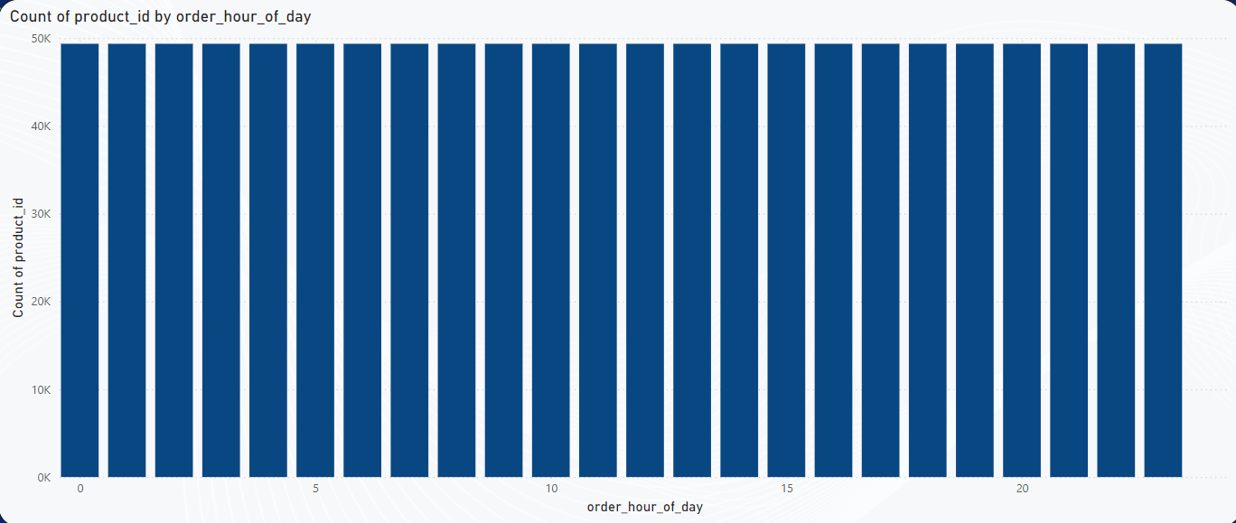
Count of Products per Hour
order_hour_of_day | Count of product_id
0 | 49355
1 | 49355
2 | 49355
3 | 49355
4 | 49355
5 | 49355
6 | 49355
7 | 49355
8 | 49355
9 | 49355
10 | 49355
11 | 49355
12 | 49355
13 | 49355
14 | 49355
15 | 49355
16 | 49355
17 | 49355
18 | 49355
19 | 49355
20 | 49355
21 | 49355
22 | 49355
23 | 49355
The dataset provides information on the count of product_id (products available or ordered) across different hours of the day (from 0 to 23). Each hour has a consistent count of 49355 product_ids, indicating an even distribution of products available or ordered across all hours of the day.

Slide 16
The count of product_ids remains constant throughout all 24 hours of the day (49355), suggesting that there is no fluctuation in the product catalog or orders based on the time of day.
This consistent count of product IDs might indicate that the dataset is either showing product availability rather than order volume, or it represents products available for sale, with a constant supply across every hour.
Since the data shows a uniform count across all hours, it could indicate that the product catalog or availability remains stable at all times. Here are some insights:
1. 24/7 Availability
If the data represents product availability, the consistent numbers show that there is no difference in product variety across hours. This could be important for businesses that operate around the clock or are interested in ensuring consistent product availability for their customers at any time.
2. Opportunity for Round-the-Clock Sales Strategies
The uniform availability of products across the day suggests that businesses may want to focus on 24/7 promotional campaigns, knowing that product availability is constant. This can lead to:
  Targeted marketing strategies for specific times of day.
  Flexible inventory management, where products are continuously available, and orders can be placed without concern for product shortage due to time of day.
3. Sales and Marketing Considerations
If this data represents sales data and product availability remains consistent, consider:
  Promotional offers or campaigns that are not dependent on specific hours since product availability is stable.
  Using a consistent product catalog to align marketing efforts without needing to adjust for varying inventory levels by time of day.

Slide 17
Lack of Variability in Product Distribution
The uniform product count could also suggest a lack of seasonal or time-of-day based demand patterns in the data. If the sales patterns are truly consistent, businesses may want to look at other factors for sales insights, such as:
  Product preferences based on demographic information rather than time of day.
  Marketing strategies that focus on customer behaviors or preferences rather than hourly availability.
Potential Recommendations for Businesses:
Monitor for Changing Trends: While the data is currently showing consistent numbers, it's important to monitor whether any changes arise over time, such as new product releases, seasonal shifts, or changes in consumer behavior.
Enhance User Experience: Consider ensuring that your product catalog is equally accessible at all times (if this data represents availability) to offer customers the freedom to shop at their convenience, regardless of the time.
Promotions: If the product count represents sales, explore offering 24/7 discounts or promotional offers that are not limited by time, capitalizing on the fact that products are consistently available.
Operational Efficiency: Ensure that inventory management systems are optimized for 24/7 operations, particularly if this dataset represents product availability across hours.

Slide 18
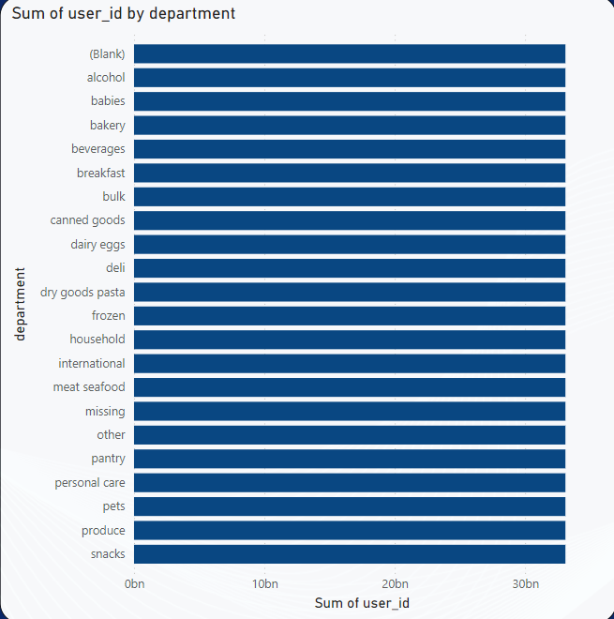
Sum of User-id per Department
Overview of the Data
This Table shows the sum of user_ids across various departments in a retail or grocery environment. The same value, 33,097,267,083, is listed for all departments, which suggests that this data might represent a total or aggregate count of users who have interacted with products in each department. This suggests equal user interaction or engagement across all departments.
Sum of user_id | department
33097267083
33097267083 | alcohol
33097267083 | babies
33097267083 | bakery
33097267083 | beverages
33097267083 | breakfast
33097267083 | bulk
33097267083 | canned goods
33097267083 | dairy eggs
33097267083 | deli
33097267083 | dry goods pasta
33097267083 | frozen
33097267083 | household
33097267083 | international
33097267083 | meat seafood
33097267083 | missing
33097267083 | other
33097267083 | pantry
33097267083 | personal care
33097267083 | pets
33097267083 | produce
33097267083 | snacks

Slide 19
The sum of user_ids is the same for each department (33,097,267,083), indicating that users have shown equal interest or engagement across all product categories.
Departments listed include a variety of categories such as:
Core grocery departments: Alcohol, bakery, dairy eggs, frozen, meat seafood, etc.
Specialized departments: Personal care, pets, international, pantry, and household.
Snacks and breakfast as consumer-oriented categories.
Insights for Business Strategy
Given the uniform engagement across all departments, there are several key business insights and opportunities:
1. Consistent Consumer Interest
Consumers appear to be engaging uniformly with various product categories, showing interest in a wide array of products. This suggests that customers have a broad purchasing behavior across all sections of the store.
2. Opportunities for Cross-Department Marketing
With engagement equally distributed across departments, there is a significant opportunity to run cross-departmental marketing campaigns. Businesses can leverage this to promote bundles or offer discounts on products from multiple departments at once.
  For example, a "Breakfast + Beverages" bundle or a "Household + Personal Care" package.
3. Equal Focus on Core and Specialized Products
The engagement across both core grocery categories (bakery, dairy eggs, frozen) and more specialized categories (personal care, pets, international) implies that businesses should not ignore niche markets. Even less-visited departments like pets and personal care may show strong potential.
  Recommendation: Ensure that the marketing and stocking strategies give equal importance to specialty products and core products.
4. Promotional Campaigns Based on User Behavior
Since the sum of user engagement across departments is uniform, businesses can launch storewide promotions or store loyalty programs to encourage further engagement. These could be tailored to each department equally, ensuring that promotions reach customers across all categories.

Slide 20
Opportunities for Inventory and Stock Optimization
1. Uniform Stocking and Availability
Given that customers interact uniformly with all departments, there is a need for consistent stock levels across all product categories. Low stock in any department might deter customers from engaging, leading to missed sales opportunities.
2. Streamlined Logistics
The uniform engagement across all departments suggests that logistical strategies (inventory management, restocking, and fulfillment) should be consistent across the board. Efficient supply chains and restocking strategies will ensure that no department faces shortages, keeping the store’s operations smooth and maximizing sales potential.
Cross-Department Campaigns:
  Consider running store-wide campaigns that encourage shoppers to explore multiple departments. Examples include special discounts or targeted emails that promote products across multiple sections.
  Example: A "Buy 1, Get 1 Free" promotion on Snacks and Beverages.
Customer Engagement:
  Given that users engage with multiple departments, interactive marketing strategies such as loyalty programs, referral bonuses, or personalized recommendations can help retain users and increase overall sales.
Focus on Niche Products:
  Even though core categories like Bakery and Dairy are important, niche categories such as Pets and Personal Care should not be overlooked, as there seems to be significant engagement in those departments.

Slide 21
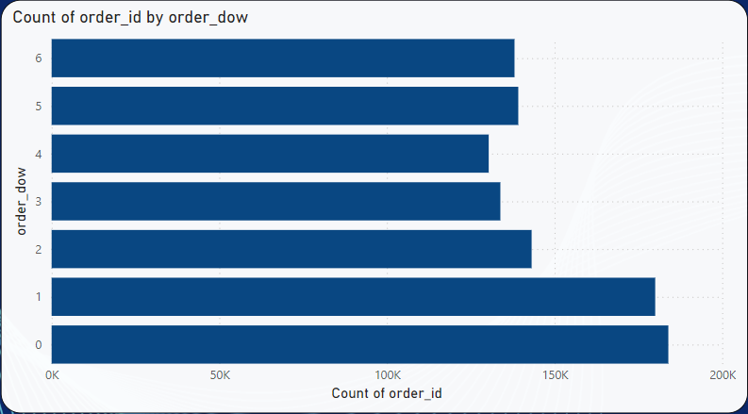
Total Count of Orders Per Weak
order_dow | Count of order_id
0 | 183939
1 | 180025
2 | 143162
3 | 133839
4 | 130367
5 | 139183
6 | 138060
This dataset shows the count of order_id across the days of the week (order_dow). The values represent the number of orders placed on each day, where:
0 corresponds to Sunday,
1 corresponds to Monday,
2 corresponds to Tuesday,
3 corresponds to Wednesday,
4 corresponds to Thursday,
5 corresponds to Friday, and
6 corresponds to Saturday.

Slide 22
Highest Order Volume:
Sunday (0) has the highest number of orders (183,939), followed by Monday (1) with 180,025 orders.
Lowest Order Volume:
Thursday (4) shows the lowest number of orders (130,367), suggesting a potential dip in demand towards the mid-week.
Even Distribution:
There is a relatively even distribution of orders across the rest of the days, with Tuesday (143,162) having the third highest count, and Saturday (138,060) the second lowest.
Weekend Peaks in Orders
Sunday and Monday see the highest number of orders, with Sunday being the clear peak. This suggests that consumers may be placing larger or more numerous orders at the end of the weekend or early in the week.
  Opportunity: Focus on promotional campaigns or marketing offers at the beginning of the week (e.g., Sunday/Monday deals) to capture the peak demand and drive higher sales during these days.
Mid-week Drop in Orders
Thursday has the lowest number of orders, indicating a possible mid-week dip in consumer engagement.
  Recommendation: Explore running special promotions or discounts specifically on Thursdays to boost sales during this slower period. You could also consider scheduling flash sales or targeted ads to reignite interest.
3. Consistent Weekday Activity
The overall number of orders remains fairly steady across Tuesday to Saturday, with only small fluctuations. This implies that consumers are regularly engaging with your offerings throughout the week, albeit at a slightly lower rate.
  Opportunity: Maintain consistent engagement strategies, such as targeted marketing emails or discounts, during these days to sustain customer interest and increase order volumes.

Slide 23
Marketing and Sales Opportunities
1. Promotional Strategies Based on Order Trends
Weekend Strategy: Use the high order volume on Sunday and Monday to push larger or special promotions such as:
  "Weekend Special" offers (Sunday-Monday deals)
  Targeted marketing around Sunday/Monday to increase engagement.
Mid-week Strategy: To combat the dip in orders on Thursday, consider running mid-week offers or even loyalty rewards for customers shopping on Thursdays.
  Thursday-only promotions or special discounts on popular items could help increase order volume during this lull.
2. Targeted Advertising
Invest in data-driven advertising to target customers who are most likely to shop on peak days (Sunday and Monday) with exclusive offers that encourage additional purchases.
3. Optimizing Inventory and Fulfillment
Knowing the peak order days, businesses can optimize their inventory management and fulfillment operations. Stocking popular products heavily ahead of Sunday and Monday and ensuring a streamlined process for quicker order fulfillment on peak days can help maintain efficiency.
Recommendations for Future Strategy
Leverage Peak Days for Larger Sales:
  Focus marketing efforts, stock availability, and promotions to coincide with high-order days (Sunday and Monday). Promote special bundles or larger discounts during these days.
Mid-week Engagement:
  Run flash sales or other targeted promotions during Thursday to offset the mid-week dip.
  Offer loyalty rewards or exclusive deals for customers who purchase on Thursdays, to build consistent traffic throughout the week.

Slide 24
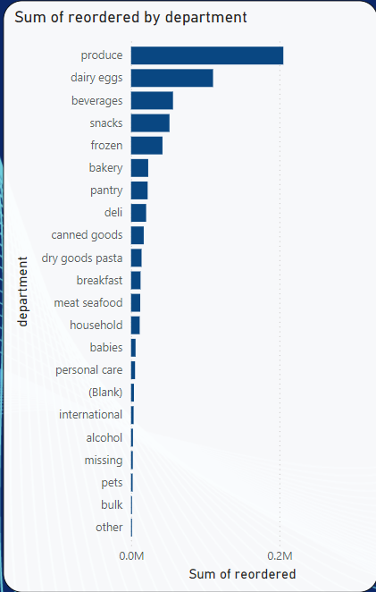
Total Products Reordered Per Department
department | Sum of reordered
produce | 205308
dairy eggs | 110545
beverages | 56556
snacks | 51816
frozen | 42369
bakery | 23124
pantry | 22375
deli | 20351
canned goods | 17121
dry goods pasta | 14162
breakfast | 12802
meat seafood | 12380
household | 11649
babies | 6076
personal care | 5412
 | 3898
international | 3435
alcohol | 2581
missing | 2385
pets | 2150
bulk | 582
other | 531
This dataset presents the sum of reordered products across different departments in a retail environment. The numbers indicate how many products from each department have been reordered by customers, giving insight into customer preferences and shopping behavior across various product categories.

Slide 25
High Reorder Rate:
Produce leads the list with the highest number of reorders (205,308), indicating a high demand for fresh produce.
Dairy & Eggs also sees a significant number of reorders (110,545), showing that essential food items are being frequently restocked by customers.
Moderate Reorder Rate:
Beverages (56,556) and Snacks (51,816) have moderate reorder counts, pointing to steady demand for these categories.
Frozen products also show a reasonable reorder rate (42,369), reflecting ongoing customer interest in frozen items.
Low Reorder Rate:
Specialized categories like Alcohol (2,581), Pets (2,150), and Bulk (582) have much lower reorder counts, suggesting that these categories might be more niche, or customers are not as likely to reorder products frequently.
Missing (2,385) could indicate either incomplete data or a category with low visibility

Slide 26
Focus on High-Demand Products
Produce and Dairy & Eggs are clearly high-priority categories. To capitalize on their popularity:
  Create subscription services for regular delivery of fresh produce or dairy products.
  Loyalty programs could be implemented for customers purchasing from these categories frequently, offering discounts or rewards for repeat purchases.
Targeted Promotions for Beverages and Snacks
Given the high reorder rates in Beverages and Snacks, consider running bundling campaigns to encourage customers to buy these items together. Example:
  "Buy 2 Snacks, Get 1 Beverage Free" or "Weekend Snack Pack with Beverages."
Seasonal Campaigns for Niche Categories
Alcohol, Pets, and Bulk products can benefit from seasonal promotions. For example:
  Alcohol could see a sales boost during holidays or celebrations.
  Pets products could see increased sales during pet awareness months.
  Bulk items could be promoted as cost-effective solutions for families or businesses looking to stock up.

Slide 27
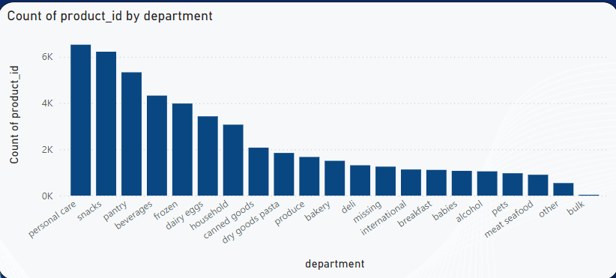
Total Count od Product per Department
department | Count of product_id
personal care | 6524
snacks | 6221
pantry | 5331
beverages | 4324
frozen | 3982
dairy eggs | 3428
household | 3068
canned goods | 2073
dry goods pasta | 1845
produce | 1671
bakery | 1506
deli | 1312
missing | 1254
international | 1131
breakfast | 1113
babies | 1071
alcohol | 1049
pets | 968
meat seafood | 903
other | 543
bulk | 38
This dataset shows the count of product_ids across various departments, giving us a clear picture of the relative number of distinct products in each department. The count of product_id reflects how many unique products are offered within each department.

Slide 28
Key Observations
1. High Product Counts:
Personal Care leads with the highest count of product_ids (6,524), indicating a broad variety of personal care items available for customers.
Snacks follows with 6,221 unique products, suggesting a significant variety in snack offerings.
Pantry (5,331) and Beverages (4,324) also contain a high number of unique products, reflecting the extensive range of staple food and drink options available.
2. Moderate Product Counts:
Frozen products (3,982) and Dairy & Eggs (3,428) show moderate counts of unique items, signaling diverse selections, but not as many as the higher-ranking departments.
Household (3,068) and Canned Goods (2,073) also show a good number of products, serving as essential categories for many households.
3. Low Product Counts:
Bulk has a notably low number of unique products (38), indicating that it is a smaller, more niche category, or it may represent a very specific subset of goods.
Other (543) and Meat & Seafood (903) also have relatively low numbers of unique products, possibly due to limited variety in these categories.
4. Missing Products:
Missing (1,254) represents products with an unspecified category, and could be an area for data improvement.

Slide 29
Insights for Business Strategy
1. Expanding Product Variety in High Demand Departments
Personal Care and Snacks are the leading departments in terms of product variety. A broad selection of products in these categories suggests:
  Personal Care likely caters to a diverse customer base, ranging from skincare to hygiene products.
  Snacks offers a wide range of choices, appealing to a broad consumer demographic.
  Opportunity: Ensure frequent stock updates and keep expanding the product assortment in these categories to capture emerging trends and customer needs.
2. Focus on Essential Categories
Categories like Pantry, Beverages, and Frozen offer a solid range of products. The diversity of items in these categories positions them as core offerings for regular purchases.
  Opportunity: Use inventory management to avoid stockouts and promote high-demand pantry or beverage items more frequently to boost sales.
3. Addressing Smaller Categories (Bulk, Other, Meat & Seafood)
Bulk and Other have significantly fewer product offerings. These smaller categories could benefit from strategic expansion.
  Recommendation: Evaluate customer preferences in the Bulk and Other categories and consider introducing specialty items or limited edition products to expand their appeal.
  Meat & Seafood also offers limited variety compared to other departments. Expanding product options in these sections could cater to a growing demand for diverse meat and seafood products.
4. Investigate "Missing" Category
Missing items should be reviewed to ensure they are correctly categorized. This could also indicate a need for data cleanup and might affect business decisions related to inventory and marketing.

Slide 30
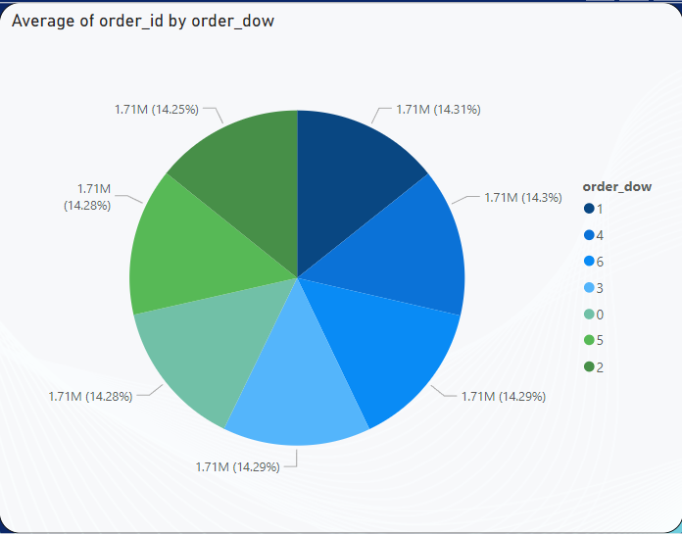
Average Orders Per Day of The Weak
order_dow | Average of order_id
1 | 1713626.88
4 | 1712653.87
6 | 1711541.37
3 | 1711492.03
0 | 1710516.39
5 | 1710480.64
2 | 1706102.81
This Table represents the average number of orders by day of the week (order_dow). It helps us understand customer behavior and order patterns across different days.

Slide 31
Key Observations
Peak Order Days:
Monday (1) shows the highest average number of orders at 1,713,626.88, indicating that customers are more likely to place orders at the beginning of the week.
Thursday (4) follows closely with an average of 1,712,653.87 orders. This suggests that mid-week is also a popular time for placing orders.
Low Order Days:
Tuesday (2) has the lowest average order volume at 1,706,102.81 orders, though the difference compared to other days is not significantly large. This could indicate a minor dip in orders at the start of the workweek.
Steady Patterns:
The order volume remains fairly consistent across most days of the week, with only slight fluctuations.
Friday (5) and Saturday (6) have similar average order numbers (around 1,710,000), which shows consistent ordering behavior through the weekend.
Subtle Decrease on Weekends:
There is a small dip in order volumes as the week progresses toward the weekend, particularly noticeable in Sunday (0) with an average of 1,710,516.39 orders.

Slide 32
Insights for Business Strategy
1. Focusing on High-Volume Days (Monday and Thursday)
Monday and Thursday consistently show high order volumes.
  Opportunity: Optimize marketing campaigns and promotions for these days, such as special discounts or exclusive deals to drive even higher volumes.
2. Maintaining Consistency Through the Week
Despite fluctuations, the order numbers remain relatively stable throughout the rest of the week.
  Opportunity: Ensure consistent product availability and customer service quality throughout the week, with a focus on maintaining high standards even on lower-order days like Tuesday.
3. Weekend Strategies
Saturday and Sunday show a slight decrease in average order volume, but the orders are still relatively high.
  Recommendation: Consider weekend-specific promotions or bundling strategies to encourage weekend shoppers and prevent a decline in weekend orders.

Slide 33
4. Operational Planning
The slight dip on Tuesday and Sunday may be reflective of general consumer behavior or workweek routines.
  Opportunity: Adjust staffing levels and inventory management to optimize operations for these days, ensuring availability of popular products when demand spikes on high-order days like Monday and Thursday.
Marketing and Sales Strategy
1. Capitalizing on High-Order Days:
Monday and Thursday are ideal days to introduce new products, special promotions, and flash sales to drive even higher engagement and sales during peak periods.
2. Weekend Engagement:
For Saturday and Sunday, introduce weekend deals, limited-time offers, or free shipping to push higher conversion rates during the slightly lower order volume days.
3. Data-Driven Insights for Campaigns:
By analyzing specific trends over these days, tailor your advertising strategy for the times when customers are most likely to make a purchase. For example:
  On Monday, highlight "Fresh Start" promotions for the week ahead.
  On Thursday, target shoppers with "Weekend Ready" campaigns.

Slide 34
Average of reordered and Count of product_id by aisle
aisle | Count of product_id | Average of reordered | aisle2 | Count of product_id3 | Average of reordered4 | aisle3 | Count of product_id6 | Average of reordered7 | aisle4 | Count of product_id9 | Average of reordered10
milk | 24670 | 0.79 | frozen pizza | 5876 | 0.6 | buns rolls | 3812 | 0.54 | missing | 6220 | 0.38
water seltzer sparkling water | 27879 | 0.74 | packaged cheese | 31453 | 0.6 | packaged meat | 1173 | 0.54 | honeys syrups nectars | 2158 | 0.38
fresh fruits | 113658 | 0.74 | frozen meals | 13817 | 0.6 | bulk grains rice dried goods | 484 | 0.54 | oils vinegars | 8059 | 0.37
eggs | 14902 | 0.73 | energy granola bars | 13161 | 0.6 | fresh herbs | 11345 | 0.54 | asian foods | 5329 | 0.36
packaged produce | 10136 | 0.71 | chips pretzels | 23280 | 0.6 | specialty wines champagnes | 361 | 0.53 | trash bags liners | 1235 | 0.36
cream | 9255 | 0.7 | dog food care | 1216 | 0.59 | tea | 6994 | 0.53 | kosher foods | 476 | 0.36
soy lactosefree | 19924 | 0.69 | crackers | 14740 | 0.59 | nuts seeds dried fruit | 9375 | 0.52 | oral hygiene | 2303 | 0.36
yogurt | 41573 | 0.69 | frozen vegan vegetarian | 3588 | 0.59 | canned meat seafood | 2255 | 0.51 | salad dressing toppings | 3652 | 0.36
white wines | 815 | 0.68 | popcorn jerky | 5256 | 0.59 | specialty cheeses | 2814 | 0.51 | body lotions soap | 1558 | 0.35
bread | 17761 | 0.68 | cereal | 12377 | 0.59 | hot cereal pancake mixes | 4766 | 0.51 | muscles joints pain relief | 673 | 0.35
packaged vegetables fruits | 59341 | 0.66 | granola | 2863 | 0.59 | pasta sauce | 7175 | 0.51 | facial care | 541 | 0.35
cat food care | 2176 | 0.66 | other creams cheeses | 9689 | 0.59 | bakery desserts | 1125 | 0.5 | soap | 2080 | 0.35
breakfast bakery | 7445 | 0.65 | bulk dried fruits vegetables | 551 | 0.58 | instant foods | 7421 | 0.5 | air fresheners candles | 788 | 0.35
soft drinks | 12279 | 0.65 | red wines | 957 | 0.58 | spreads | 9183 | 0.5 | condiments | 7436 | 0.34
refrigerated | 17620 | 0.65 | hot dogs bacon sausage | 9626 | 0.58 | protein meal replacements | 1224 | 0.49 | vitamins supplements | 1486 | 0.33
frozen breakfast | 7320 | 0.65 | packaged poultry | 2674 | 0.57 | dry pasta | 8583 | 0.48 | feminine care | 786 | 0.33
tofu meat alternatives | 3876 | 0.65 |  | 6825 | 0.57 | preserved dips spreads | 3919 | 0.48 | cleaning products | 4474 | 0.32
energy sports drinks | 3494 | 0.64 | candy chocolate | 8610 | 0.57 | diapers wipes | 852 | 0.48 | baking ingredients | 9796 | 0.31
mint gum | 743 | 0.64 | cookies cakes | 7500 | 0.56 | ice cream ice | 16863 | 0.48 | shave needs | 392 | 0.3
poultry counter | 3986 | 0.64 | frozen produce | 17076 | 0.56 | frozen juice | 205 | 0.48 | marinades meat preparation | 2215 | 0.29
prepared meals | 3084 | 0.63 | canned fruit applesauce | 3054 | 0.56 | frozen dessert | 696 | 0.47 | ice cream toppings | 367 | 0.29
trail mix snack mix | 1080 | 0.63 | tortillas flat bread | 6305 | 0.56 | pickled goods olives | 3746 | 0.47 | more household | 656 | 0.28
fresh dips tapenades | 11374 | 0.62 | frozen meat seafood | 2558 | 0.56 | laundry | 3474 | 0.46 | skin care | 407 | 0.28
coffee | 6291 | 0.61 | refrigerated pudding desserts | 1326 | 0.56 | canned jarred vegetables | 9536 | 0.45 | deodorants | 653 | 0.27
fresh vegetables | 114214 | 0.61 | frozen breads doughs | 1120 | 0.55 | soup broth bouillon | 11413 | 0.45 | eye ear care | 402 | 0.27
breakfast bars pastries | 2379 | 0.61 | packaged seafood | 690 | 0.55 | indian foods | 555 | 0.44 | hair care | 1095 | 0.26
spirits | 710 | 0.61 | paper goods | 9619 | 0.55 | cocoa drink mixes | 793 | 0.43 | food storage | 2188 | 0.26
lunch meat | 12502 | 0.6 | fresh pasta | 1253 | 0.55 | digestion | 849 | 0.43 | baby bath body care | 245 | 0.26
juice nectars | 10476 | 0.6 | seafood counter | 799 | 0.55 | latino foods | 2584 | 0.42 | beauty | 203 | 0.23
butter | 8013 | 0.6 | baby food formula | 9990 | 0.55 | grains rice dried goods | 4665 | 0.42 | first aid | 426 | 0.23
fruit vegetable snacks | 5075 | 0.6 | frozen appetizers sides | 6645 | 0.55 | doughs gelatins bake mixes | 3505 | 0.42 | cold flu allergy | 1004 | 0.22
prepared soups salads | 2223 | 0.6 | canned meals beans | 8862 | 0.54 | plates bowls cups flatware | 1452 | 0.41 | kitchen supplies | 333 | 0.18
beers coolers | 1414 | 0.6 | baby accessories | 239 | 0.54 | dish detergents | 2911 | 0.4 | baking supplies decor | 813 | 0.18
 |  |  | meat counter | 2381 | 0.54 | other | 1355 | 0.39 | spices seasonings | 6999 | 0.16

Slide 35
Key Insights
Top Aisles with Highest Reorder Rates:
Milk (0.79): This aisle has the highest reorder rate, indicating it contains essential items that customers frequently restock.
Water, Seltzer, Sparkling Water (0.74) and Fresh Fruits (0.74): These aisles also have high reorder rates, signifying that they are popular products with regular customer demand.
Eggs (0.73) and Packaged Produce (0.71): These aisles exhibit strong reorder tendencies as customers tend to repurchase these items frequently.
Aisles with Moderate Reorder Rates:
Cream (0.70), Soy Lactose-Free (0.69), and Yogurt (0.69): These aisles show moderate reorder rates, suggesting that these products are frequently repurchased but not as urgently as high-demand essentials.
Bread (0.68) and Packaged Vegetables/Fruits (0.66) also show moderate reorder rates, which indicates steady but not overwhelming demand.
Aisles with Lower Reorder Rates:
Specialty Wines, Champagnes (0.53) and Fresh Herbs (0.54) have lower reorder rates, implying these products are either purchased seasonally or have niche markets.
Frozen Juice (0.48) and Frozen Dessert (0.47) also show relatively low reorder rates, suggesting that customers do not replenish these products as often, possibly due to limited consumption or occasional use.
Aisles with Minimal Reordering:
Spices & Seasonings (0.16), Kitchen Supplies (0.18), and Baby Accessories (0.54) have very low reorder rates, indicating that these are either low-frequency purchase items or used only occasionally.
First Aid (0.23), Cold Flu Allergy (0.22), and Beauty Products (0.23) are other aisles with lower reorder rates, reflecting their specialized or seasonal demand.

Slide 36
Insights for Business Strategy
Focus on High Reorder Items:
Milk, Water, and Fresh Fruits are essential and frequently reordered items, indicating consistent demand. For these aisles, businesses should ensure optimal stock levels to avoid running out of popular products.
  Actionable Insight: Use predictive analytics to anticipate demand spikes, especially during peak seasons, and ensure automated inventory management for products like milk and fresh fruits.
Promotions for Moderate Reorder Products:
Products like Cream, Yogurt, and Bread can benefit from subscription-based services or loyalty rewards programs to encourage repeat purchases.
  Recommendation: Offer discounts or bundle promotions for frequent purchases of moderately reordered products to incentivize customer loyalty.
Strategic Marketing for Low Reorder Products:
Aisles like Specialty Wines and Fresh Herbs, which have lower reorder rates, could benefit from targeted seasonal promotions or themed marketing campaigns.
  Actionable Insight: Focus on holiday promotions or exclusive product bundles to drive sales during peak seasons, such as Thanksgiving or Christmas, when products like wines and specialty foods are in higher demand.
Optimize for Lower Reorder Rate Items:
For aisles like Frozen Juice and Frozen Desserts, use targeted marketing to encourage special occasion purchases.
  Recommendation: Consider gift sets or seasonal flavors to make these items more appealing to customers looking for variety or special treats.

Slide 37
CONCLUSION
Essentials like dairy, fresh produce, and beverages should be given priority in terms of stock replenishment and promotions. This consistency in demand can be leveraged to drive loyalty programs and subscription models.
There's a growing market for health-conscious products and specialty diets. Retailers should invest in promoting these items through targeted marketing campaigns, offering bundles or promotions aimed at fitness-conscious and health-driven consumers.
These niche products should be marketed through seasonal campaigns. Offering tailored promotions around key holidays and special occasions can capture seasonal spikes in demand and create a sense of exclusivity around these premium products.
Convenience-driven consumption will continue to rise. Retailers should expand their offerings in pre-packaged meals, frozen foods, and ready-to-eat options, especially catering to customers seeking time-saving solutions.
While these products are essential, they follow a longer purchase cycle. Retailers can enhance sales through auto-renewal options, bulk discounts, or frequent-use subscription services.
These items should be marketed with strategic discounts and limited-time offers to entice customers. Their lower reorder rates may also indicate a need for seasonal marketing or targeted promotions around specific life events or holidays.
The market data clearly reflects evolving consumer preferences centered around convenience, health-consciousness, and essential needs. Retailers must focus on consistent availability of high-demand essentials while also capitalizing on seasonal trends for niche and specialty products. The increasing demand for convenient meal solutions and health-focused offerings presents an opportunity for brands to align with modern lifestyles.
Strategic inventory management, targeted marketing, and customer loyalty programs are crucial to capturing and retaining customers across these diverse categories. Furthermore, businesses should explore subscription services and dynamic pricing strategies to enhance customer retention and increase sales.

Slide 38
THANK YOU

